Slide 1
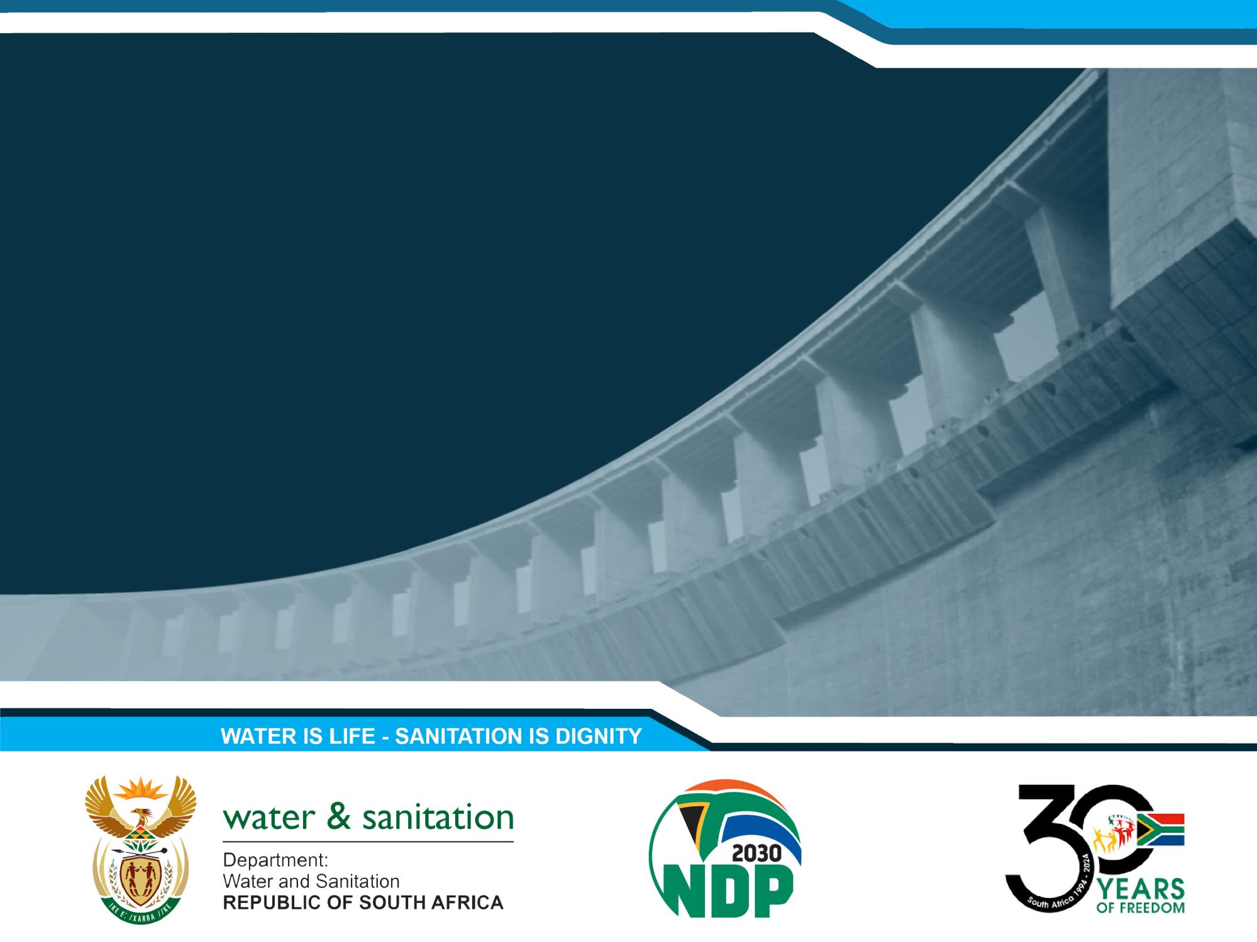
REFINEMNT OF STRATERGIC GROUNDWATER SOURCE AREAS OF SOUTH AFRICA
Public Stakeholder Meeting 01
Presented by: Date:
Umvoto
20 August 2024

Slide 2


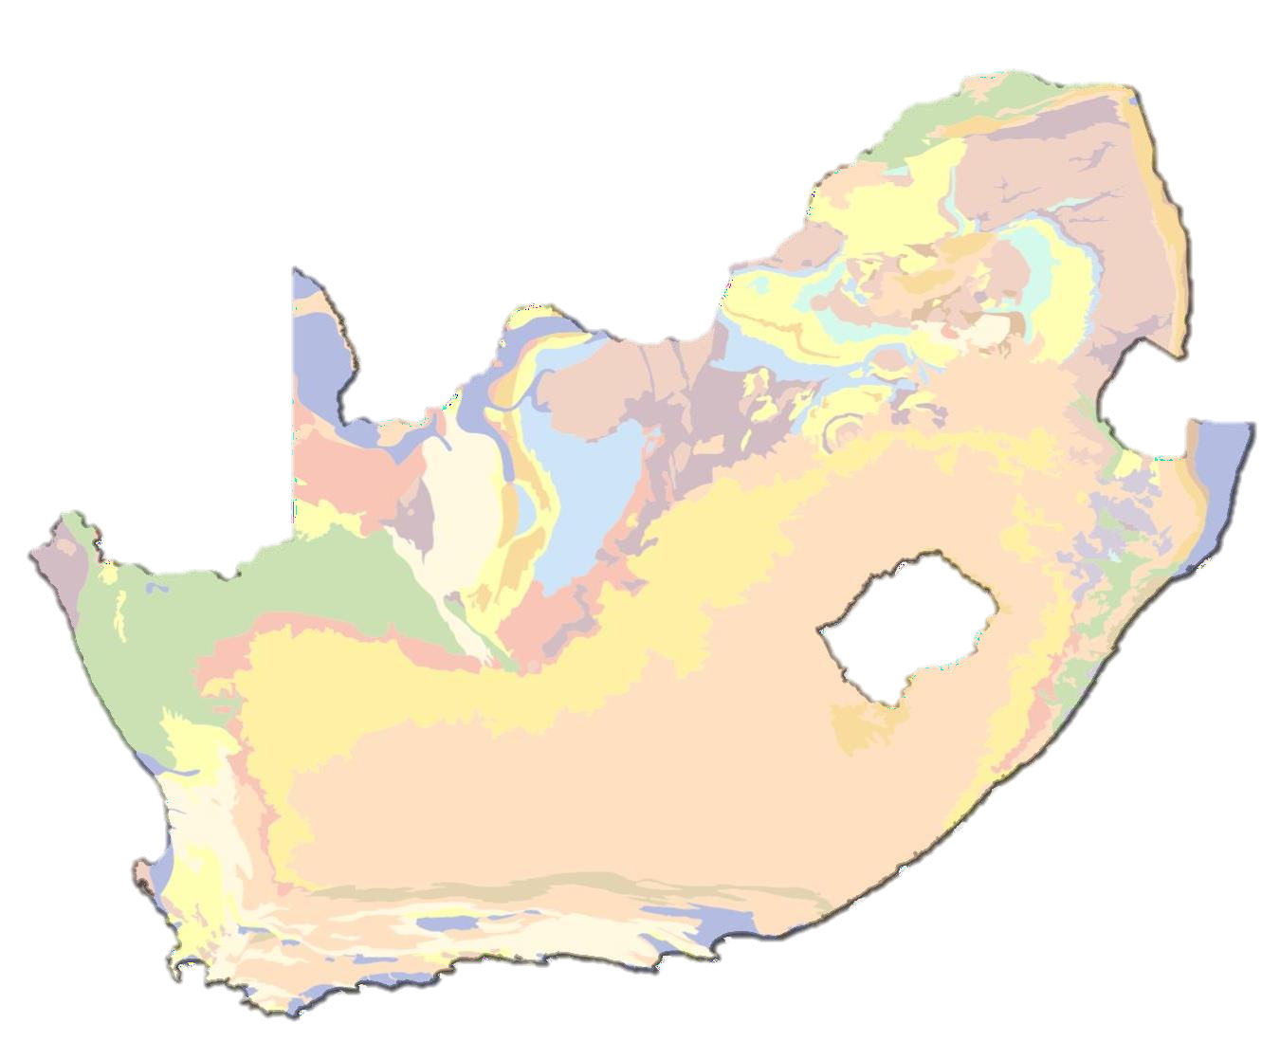
PRESENTATION OUTLINE
Umvoto South Africa (Pty) Ltd
Introduction
Background of SWSA
Project Plan
Delineation of SWSA-gw
Progress to Date
Stakeholder Engagement
Discussion

Slide 3
PROJECT OVERVIEW
Initiation
Initiated by:
PSP:
DWS Chief Directorate: Water Ecosystems Management (CD: WEM). Umvoto South Africa (Pty) Ltd.
Project Focus
Focus:
Goal:
Refine South Africa's Strategic Groundwater Source Areas (SWSA-gw) Improve the spatial accuracy SWSA-gw for South Africa and refine delineations to be aquifer-specific (where feasible).
Guide management and protective measures.
Purpose:
Implementation
Approach:
Framework:
To facilitate collaboration among government and non-government stakeholders.
Integrated Water Resource Management (IWRM) as per the National Water Act (NWA; Act No. 36 of 1998).

Slide 4















1970s
EVOLUTION OF SWSA
109 general area identified as “critical water resources”
In the early 1970s, mountain catchments in South Africa were recognized as critical Water Source Areas (WSAs), leading to conservation strategies by the Soil Conservation Board (Beinart, 1984). This effort culminated in Mountain Catchment Areas Act (Government of South Africa, 1961, Act 63 of 1970), designating 109 areas as “critical water resources”.
2001
The term “Water Source Areas” is Internationally Recognised.
The term WSAs gained broader global recognition, highlighting their role in water generation and support for lowlands (Meybeck et al., 2001).
2004
Initially identified as "high water yield catchments" during the 2004 National Spatial Biodiversity Assessment, WSAs were typically recognized as mountainous regions with higher Mean Annual Runoff (MAR) due to factors like abundant rainfall, soil composition, slope, and rock permeability. These areas, delineated from tertiary and quaternary catchments, supplied
~ 50% of South Africa's water.
WSAs delineated from tertiary and quaternary surface water catchments

Slide 5














EVOLUTION OF SWSA
2011
SWSAs @ 1x1min MAR. delineated from sub-quaternary surface water catchments
Atlas of Freshwater Ecosystem Priority Areas (NFEPAs) Included a map of SWSAs for both surface water and groundwater resources, based on 1x1 min resolution MAR layer
(Pitman, 1996) and sub-quaternary catchments with high MAR (Nel et al., 2011).
2013
21 SWSAs
@ 1.7x1.7km MAR & rainfall-runoff relationships.
First set of 21 Strategic Surface Water Source Areas (SWSA-sw) for South Africa, Lesotho, and Eswatini, finalized in 2013. These were delineated using WR2005 MAR at quaternary catchment scale and disaggregated to 1.7 x 1.7 km resolution using MAR layer and rainfall-runoff relationships. These areas cover 8% of the land surface and provide 50% of the MAR
(Nel et al., 2013; WWF-SA, 2013).
2004
Inclusion of SWSA-gw priority areas
Inclusion of groundwater along with surface water priority areas
delineated in 2013 (Smith-Adao et al., 2016).

Slide 6










EVOLUTION OF SWSA
2018
In 2018, Le Maître et al., updated the identification and delineation to include SWSA for surface and groundwater based on a 1.7 by 1.7 km resolution MAR dataset. This classification identified 22 SWSA-sw and 37 SWSA-gw, with the SWSA-gw covering ~ 9% of South Africa's land surface and contribute around 42% to baseflow.
Final set of SWSA-sw & SWSA-gw delineated @
1.7x1.7km res MAR
2021
In 2021, Lotter and Le Maître & the Department of Environment, Forestry, and Fisheries (DEFF) delineated SWSAs-sw at a finer resolution of 90 x 90 m. The refinement aimed to facilitate reliable integration into various planning, management, and regulatory processes.
This delineation replaced the broad-scale delineation of the 22 SWSA-sw developed in 2018.
Fine-scale delineation of SWSA-sw @ 90 x 90m res MAR

Slide 7
KEY POINTS ON GROUNDWATER SWSA
Groundwater Recharge
Total groundwater recharge in South Africa is 34,912 million m³/a, with 15% (5,397 million m³/a) contributed by groundwater SWSAs
(Le Maitre et al., 2019).
Overlap with Strategic Surface Water Source Areas
Many groundwater SWSAs overlap and support surface water SWSAs, playing a critical role in sustaining surface water flows and supporting groundwater-dependent ecosystems and communities.
Future Focus
Future iterations of the framework will include specific mechanisms for securing groundwater, alongside the ongoing development of aquifer management plans by the DWS for priority systems.

Slide 8
PROJECT MOTIVATION & OBJECTIVES
The project overarching aim of this project is to enhance the spatial precision and identification of South Africa's Strategic Groundwater Source Areas (SWSA-gw).
This refinement aims guide various protective and management measures and will facilitate on-the-ground resource management that aligns with the existing SWSA related policies as well as the National Water Resource Strategy (NWRS III) and NWA.
The primary objective of the project is to build upon the foundational information from previous studies, and improve the methodology for identifying and delineating SWSA-gw for both national and transboundary aquifers/aquifer systems, using the best available datasets while incorporating considerations for groundwater quality and high contribution to baseflow.

Slide 9
PROJECT PLAN
9

Slide 10















PROJECT TIMELINE
Phase
Code
Task / Deliverable
2024 2025 2026 2027
Apr May Jun Jul Aug Sep Oct Nov Dec Jan Feb Mar Apr May Jun Jul Aug Sep Oct Nov Dec Jan Feb Mar Apr May Jun Jul Aug Sep Oct Nov Dec Jan Feb Mar
P0
Project Management
P0.1
General Project Management
x x x x x x x x x x x x x x x x x x x x x x x x x x x x x x x x x x x x x x x x x x Ongoinxg x x x x x
x
P0.2
PMC Meetings
0
P0.3
PSC Meetings
x x x x x
P0.4
PS Meetings
1x 2x
P0.5
Ad Hoc Meetings
x x
x
x
x
x
P0.6
Monthly Progress Reports
x
x x x x
2 Months
x x x x x x x x x x x x x x x x x x x x x x x x x x
P0.7
Capacity Building
x
P1
Project Inception
1
T1.1.1
Lit Review
D1.1
Inception Report
x
P2
Information and Data Gathering
2
T2.1.1
Data and Information Assessment
4 Months
T2.1.2
Inventory of Water Resource Tools Assessment
D2.1
Gap Analysis Report
x
P3
Refinement of SWSA-gw
T3.1.1
Status Quo SWSA Assessment
D3.1
Status Quo SWSA Report
x
T3.2.1
Refined Methodology Assessment
D3.2
Refined Methodology Report
x
23 Months
T.3.3.1
Delineation of Refined SWSA-gw
3 T.3.3.2
Groundwater Quality
T.3.3.3
Transboundary Aquifers
T.3.3.4
Updated Status Quo SWSA Assessment
D3.3
Delineation of refined SWSA-gw Report
x
T3.4.1
SWSA-gw Protection and Management
D3.4
SWSA-gw Protection and Management
Report
x
7 Months
P4
Project Closure
T4.1.1
SWSA Main Integration
4
D4.1
Integrated Main Report
x
D4.2
External Review Report
x
D4.3
Electronic Database
x
D4.4
Close Out Report
x
10

Slide 11
PHASE 3
Phase 3 of the project is where the bulk of the work will take place. This phase will systematically review and update the methodology for identify and delineated SWSA-gw. Each deliverable of this phase represents a significant project objective and is structured into various tasks and reports.
Status Quo SWSA Report
  Refined Methodology Assessment
Refined Methodology Report
  Delineation of Refined SWSA-gw
  Groundwater Quality
  Transboundary Aquifers
  Updated Status Quo SWSA Assessment
Delineation of refined SWSA-gw Report
  SWSA-gw Protection and Management
SWSA-gw Protection and Management Report

Slide 12
DELINEATION OF SWSA FOR GROUNDWATER

Slide 13
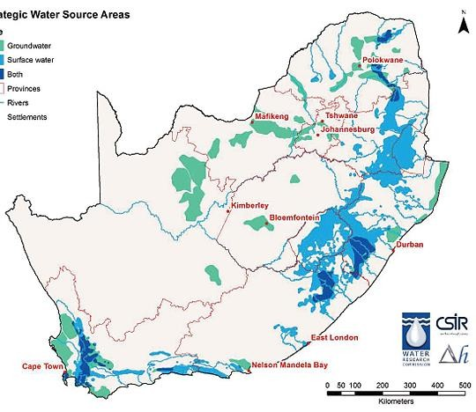
2018 SET OF SWSA
SWSA in SA
37
Groundwater
39% is groundwater (SWSA-gw)
49% is surface water (SWSA-sw)
12% are both (SWSA-both)
22
Surface Water
Both
SWSA-gw cover 9% of the surface area (~ 104 000 km²)
  SWSA-gw = 42% baseflow
  46% of the groundwater used by agriculture
  47% of the groundwater used for industrial
purposes
Total groundwater recharge (~ 34 912 Mm³/a)
  SWSA-gw contributes ~15% of the total
  SWSA-sw contributes ~33% of the total
SWSA-sw include transboundary such as Lesotho as it is critically important for the Gauteng metropolitan region.
Transboundary aquifers were considered but did not meet the criteria established for nationally important SWSA-gw
(after Le Maître et al., 2018)

Slide 14
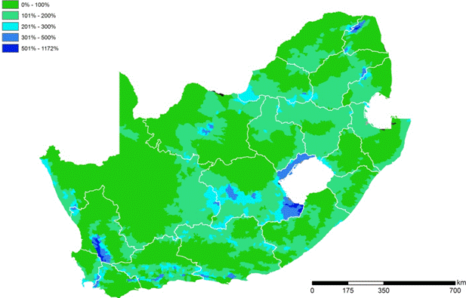
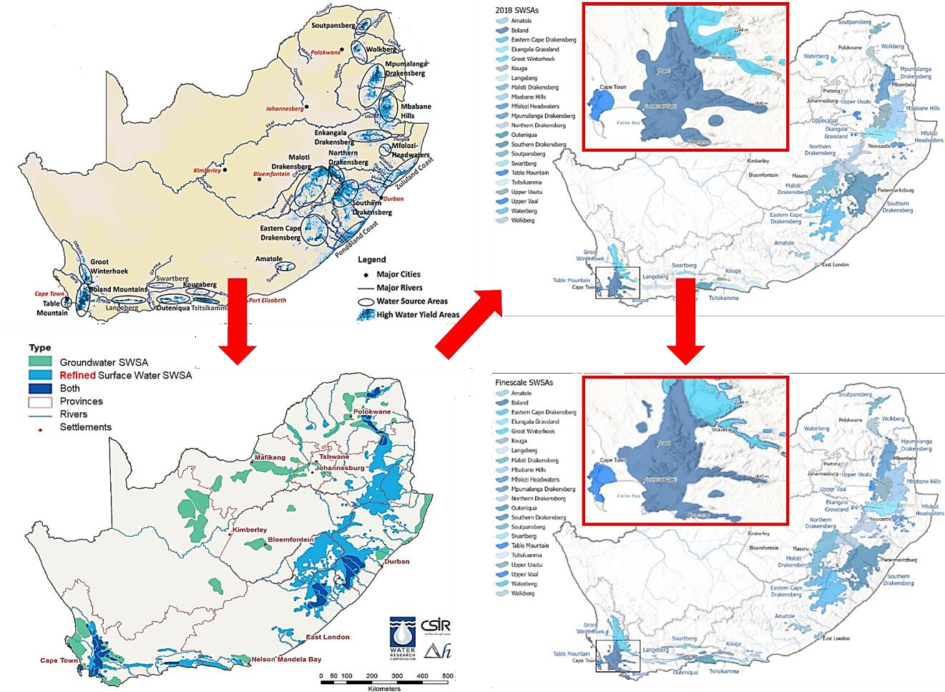



FOCUSING ON THE REFINEMENT PROCESS
2011/2013
21 general areas Identified based on
sub- quaternary catchment data
2021
From “Refined” (2018)
2018
To
“Fine-Scale” (2021)
National
22 SWSA-sw
37 SWSA-gw
Only done for 22 Surface Water SWSAs
Transboundary
SWSA-sw
  Lesotho
  Eswatini
SWSA-gw
  None

Slide 15
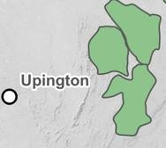
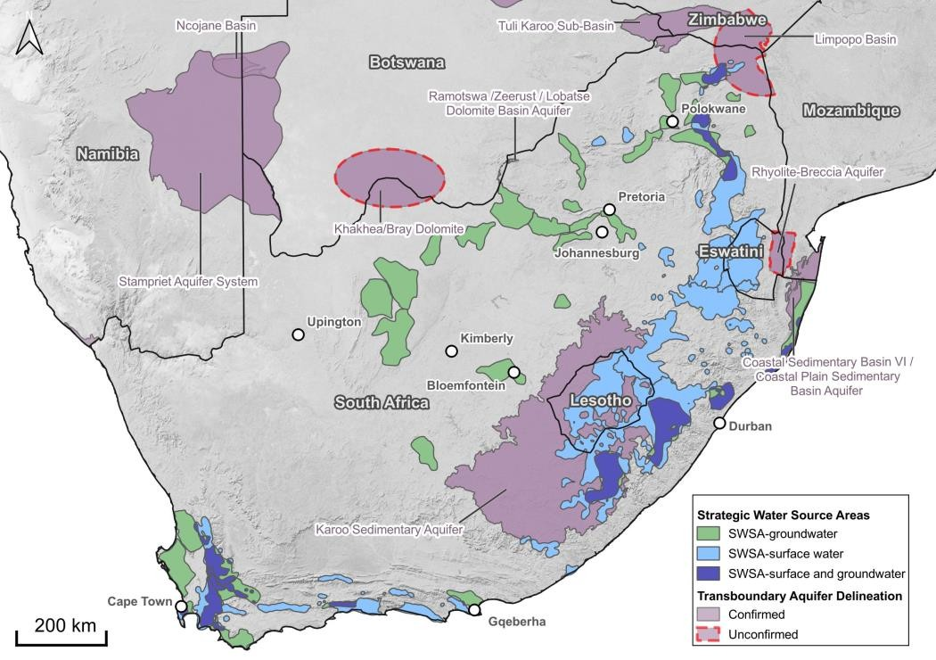
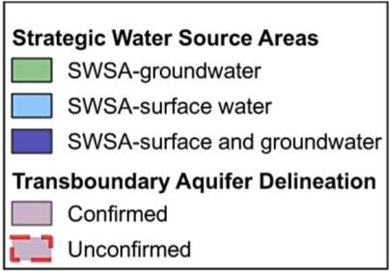
GROUNWATER SWSA REFINEMENT
A similar “refinement” process is now
required for SWSA-gw
This refinement is necessitated by the recognition of limitations within the 2018 SWSA, specifically concerning the
delineation criteria and thresholds used for identifying and delineation.
Known transboundary aquifers after IGRAC (2021)
Transboundary Aquifer Name | Countries
Tuli Karoo Sub-Basin | Botswana, South Africa, Zimbabwe
Ramotswa /Zeerust / Lobatse Dolomite Basin Aquifer | Botswana, South Africa
Rhyolite-Breccia Aquifer | South Africa, Eswatini, Mozambique
Coastal Sedimentary Basin V | South Africa, Namibia
Stampriet Aquifer System | Botswana, Namibia, South Africa
Khakhea/Bray Dolomite | Botswana, South Africa
Coastal Sedimentary Basin VI / Coastal Plain Sedimentary Basin Aquifer | Mozambique, South Africa
Karoo Sedimentary Aquifer | Lesotho, South Africa
Limpopo Basin | Mozambique, South Africa, Zimbabwe
The national and transboundary SWSA of South Africa, Lesotho, and Eswatini
showing both SWSA-sw and SWSA-gw and their overlaps.
Transboundary Aquifers from IGRAC, 2022 (Scale 1: 50 000 000) are also displayed with Partly Confirmed and Unconfirmed aquifer boundaries shown as black dashed lines.

Slide 16
FOCUSING ON THE REFINEMENT PROCESS
Groundwater Importance and Data Limitations
SWSA-gw areas often differ from SWSA-sw, highlighting the significance of groundwater in regions lacking surface water. The 2018 SWSA noted limited data availability on Groundwater Recharge, particularly at a national scale, and challenges in accurately representing groundwater use.
Methodology and Subjectivity
The criteria and thresholds used for identifying SWSA-gw aimed to provide a measurable and defensible framework, though the classification of “strategic” areas remains somewhat subjective. Economic significance alone may not fully capture the importance of groundwater sources.
Resource Protection
Areas dependent solely on groundwater, even if not classified as significant "source" areas,
are still crucial and require protection due to their reliance on groundwater resources.

Slide 17
PROGRESS TO DATE

Slide 18
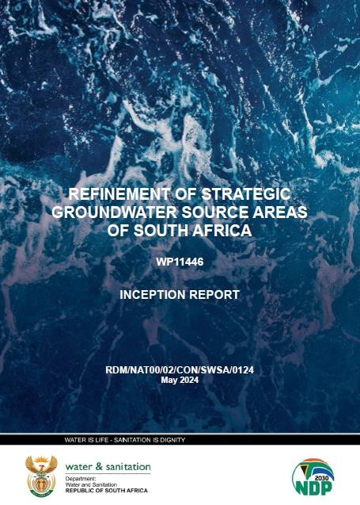
INCEPTION REPORT
Objective of the Inception Report
Establish a clear understanding of the project's scope from the outset. The elements below, as well as the associated discussions and agreements, were incorporated into a comprehensive project plan, which also details the stakeholder engagement and capacity-building program.
Report Outcomes
Project's scope (programme of deliverables & invoicing)
High-level review of existing refinement methodologies
Overview of the evolution of SWSA-gw of South Africa
Stakeholder engagement plan
Capacity-building and mentorship program
https://www.dws.gov.za/wem/currentstudies/default.aspx

Slide 19
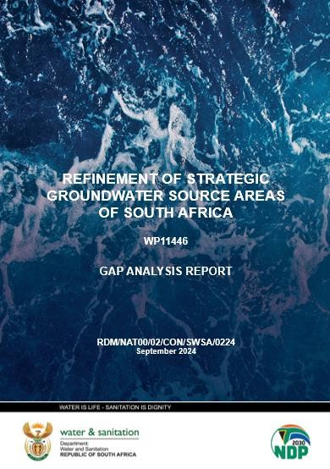
GAP ANALYSIS REPORT
Objective of the Gap Analysis Report
The aim of this report is to systematically collect, organize, review, and analyse all the relevant water resource data and information for the project, and determine if the data can confidently be used for decision-making regarding the countries water resources.
Report Outcomes
Project data catalogue
Gap analysis and impact assessment
Technical feasibility assessment
Feedback loop to incorporate new information and stakeholder feedback
Recommendations and strategic prioritization
Once finalised, the report will be published on https://www.dws.gov.za/wem/currentstudies/default.aspx

Slide 20
STAKEHOLDER ENGAGEMENT

Slide 21
STAKEHOLDER ENGAGEMENT PLAN
Stakeholder engagement is aimed at ensuring that all the concerns related to the SWSA-gw identification and refinement process are thoroughly represented and effectively addressed.
STAKEHOLDER ENGAGEMENT PLAN
Identify Key Stakeholders
  Stakeholder List (continually updated)
Define Stakeholder Motives
  PSC-01 & PS-01 (understand initial concerns)
Setup Stakeholder Comments Register
  Prioritization of comments (in consultation with DWS Project Managers)
Responses
  Documentation of Responses (in consultation with DWS PM)
Communication Channels
  PSC & PS meetings
  Email Responses
  Published Reports

Slide 22
DISCUSSION & QUESTIONS
22

